Slide 1
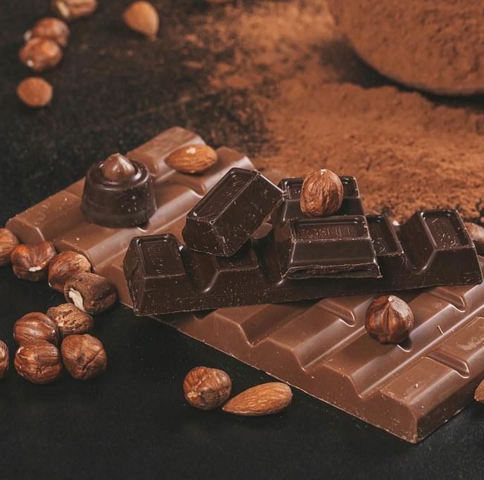
SC1015 Mini Project:
Dark Chocolate & Tastes Dataset
Lab group DSF3:
Bryan Wu
Evangeline Ng
Nguyen Bach

Slide 2
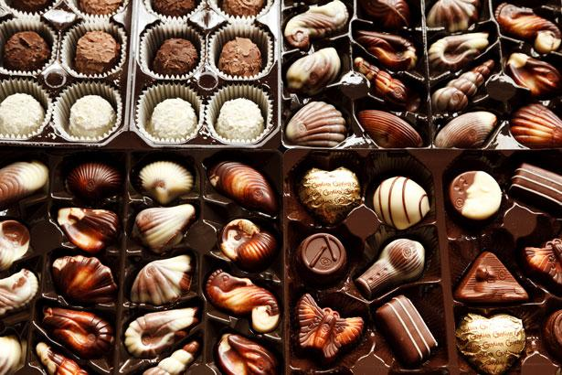
Motivation
Chocolate Industry
Dark Chocolate Market:
USD 44.09 billion in 2018.
Projected to grow to USD 83.34 billion in 2026.
One of the most popular candies in the world.
Consuming them improves heart health, elevates mood, reduce stress etc.

Slide 3
Problem Statement
01
What makes dark chocolate highly rated?

Slide 4
Motivation
Relevance of rating
Variables
The higher the rating of chocolates, the more likely it is of better quality→ consumers will be more satisfied
Cocoa bean origin
Percentage of cocoa
Ingredients
Tastes

Slide 5
Data Preparation & Exploratory Data Analysis
02

Slide 6
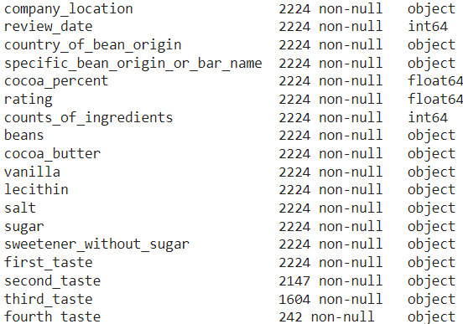
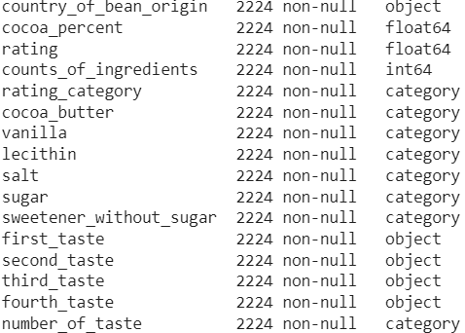
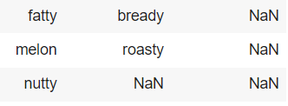
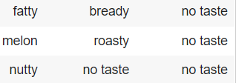
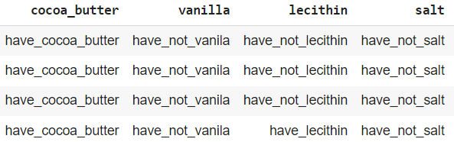
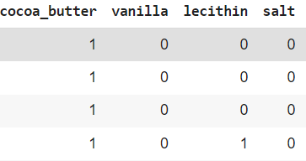
Data Preparation
Replacing NaN values with “no taste”
Modifying Variables & Column Values
Replacing column values: 1 (have); 0(don’t have)
Removed: company location, review date, specific bean origin
Added: number of tastes, rating category

Slide 7
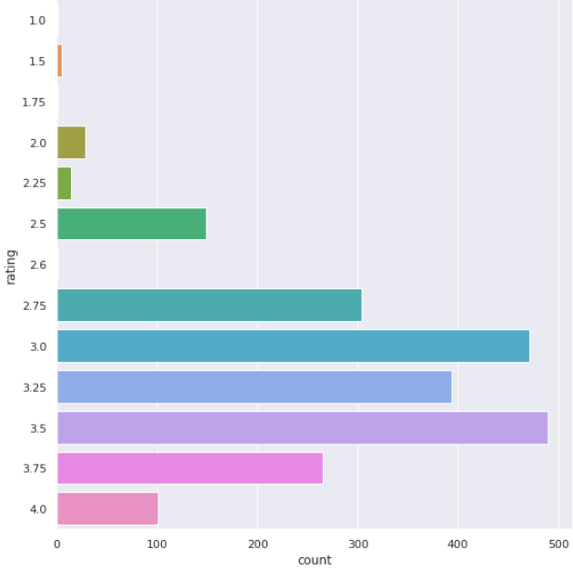
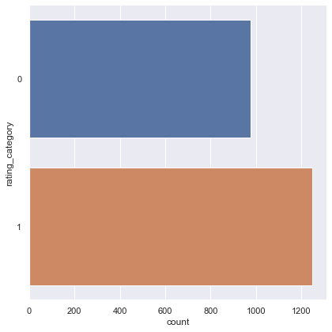
Data Preparation
Reclassifying Ratings
Rating data is too imbalanced
Reclassifying reduces data imbalance
New ratings split into 2 categories:
1-3 → low | 3-4 → high

Slide 8
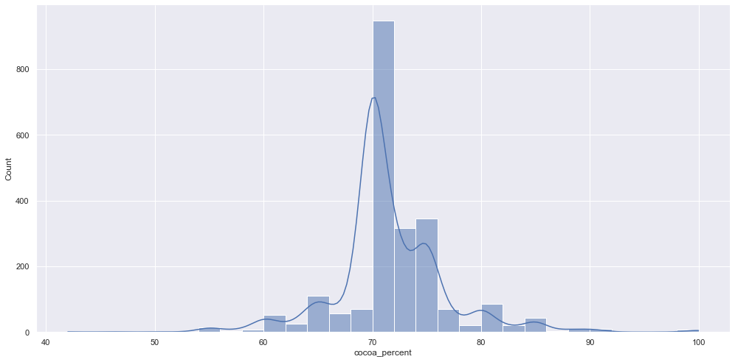
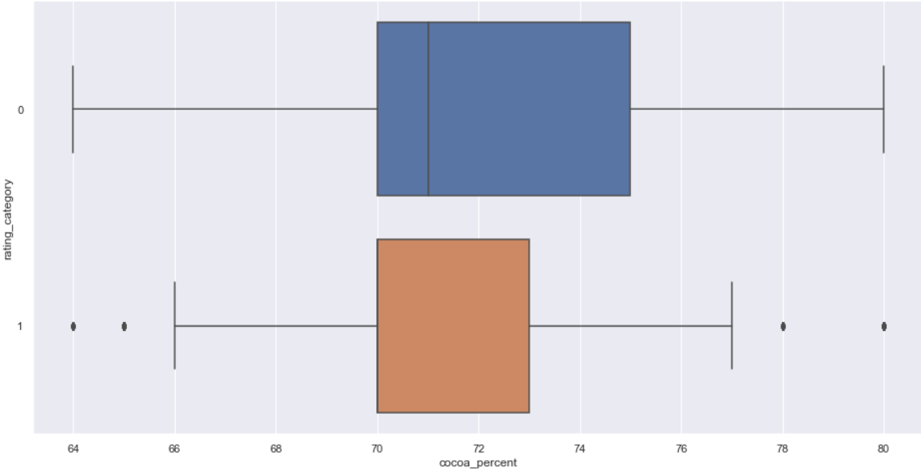
EDA
Percentage of Cocoa
Most chocolates are made up of 70-75% of cocoa
No obvious relationship with ratings
Cocoa percent in high rating chocolates vary less → 70-73%

Slide 9
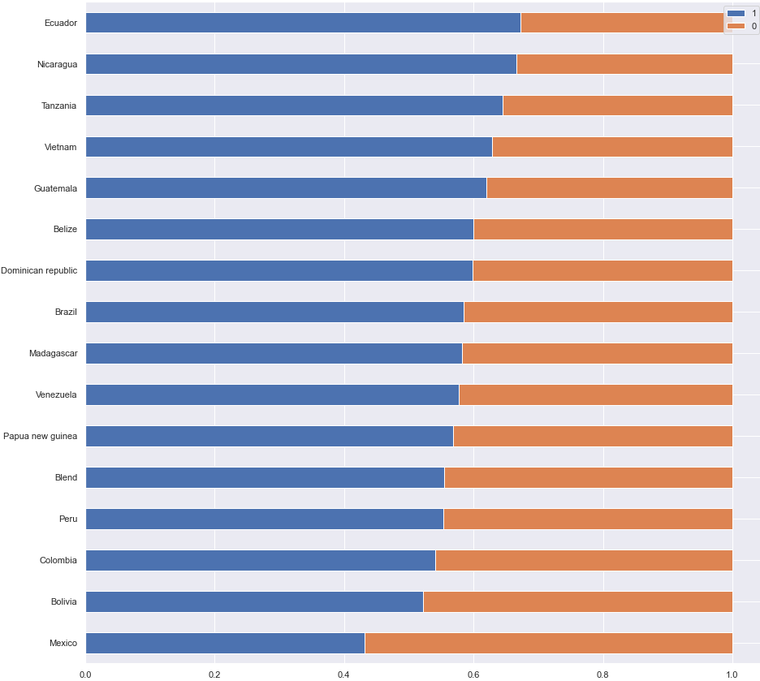
EDA
Country of Bean Origin and Proportion of Rating
Countries that has more than 50 data
We can identify cocoa bean origin countries that produce chocolates with high rating

Slide 10
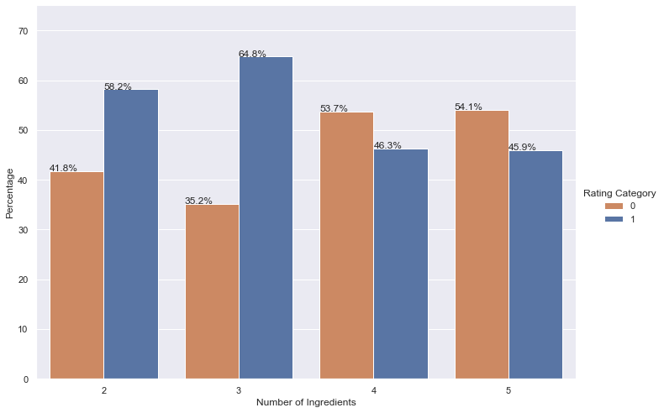
EDA
Number of Ingredients and Proportion of Rating
Outliers “1” and “6” removed
No obvious relationship between number of ingredients and ratings
2 and 3 ingredients seem to be the best zone

Slide 11
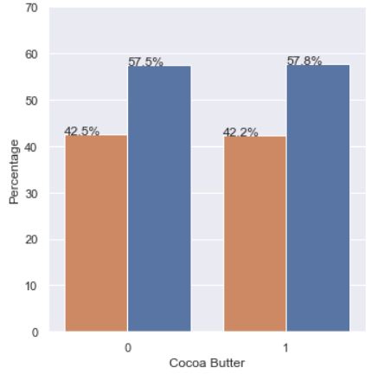
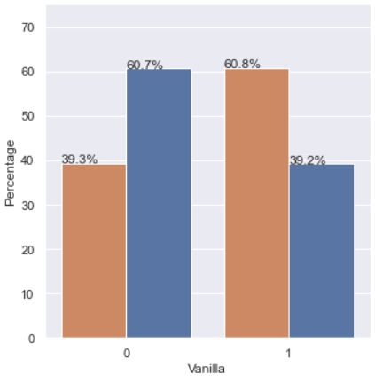
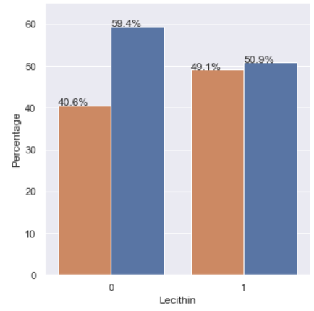
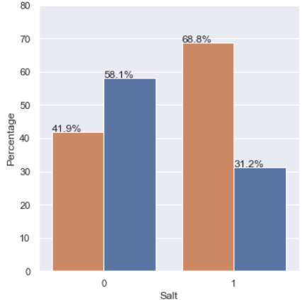
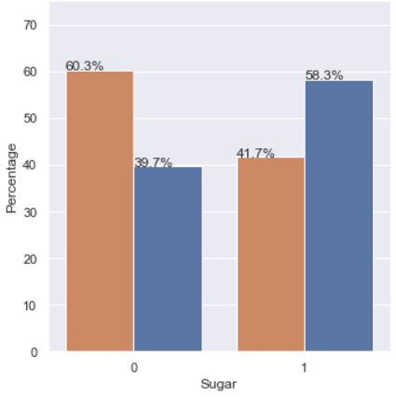
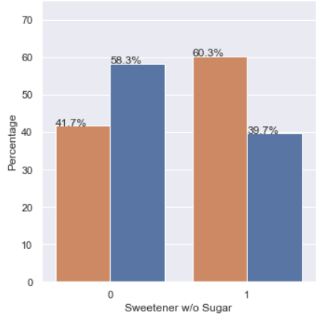

EDA
Each Ingredient and Proportion of Rating
Observe how percentage of ratings change when each ingredient is present or not
E.g. Absence of vanilla, salt, sugar (individually) caused increase in proportion of high rating

Slide 12
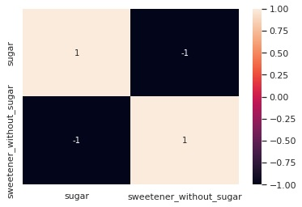
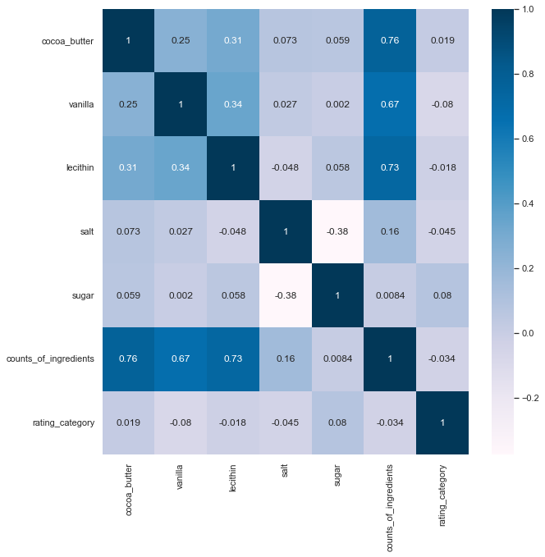
EDA
Correlation between Ingredients and Ratings
Perfect negative correlation, so we can drop one column
We can see that there is no strong relationship between ingredients and ratings

Slide 13
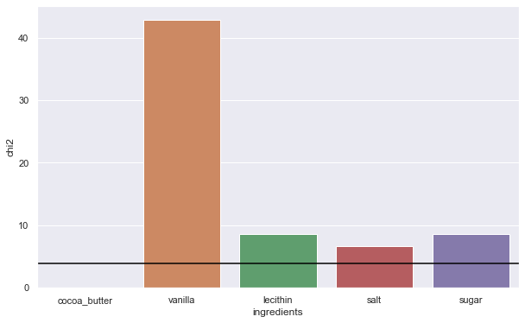
EDA
Chi-Squared Test
Furthermore, we used the chi-squared test to observe how related the ingredients are to the ratings
We can see that cocoa butter have no obvious relationship
Lecithin, salt and sugar may have some relationship
Vanilla has a clear relationship
3.84 (critical value)

Slide 14
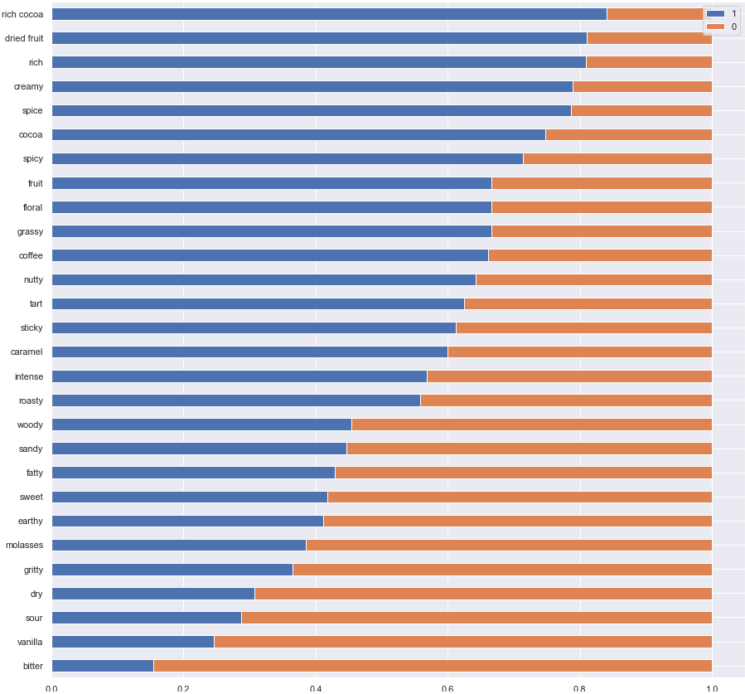
EDA
Taste and Proportion of Rating
Tastes that has >50 data
We can identify types of tastes that are more present in chocolates with high rating
Notes:
Explain why we want to have minimum 50 data points - the result shown is more reliable

Slide 15
Machine Learning
03

Slide 16

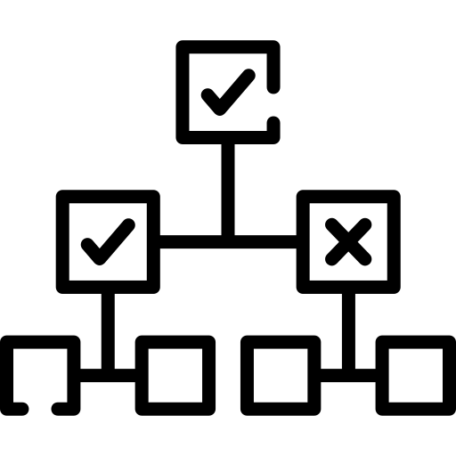

Machine Learning
3 Main Models
Random Forest
Decision Tree
Gradient Boosting

Slide 17
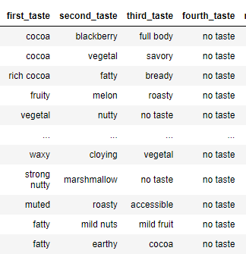
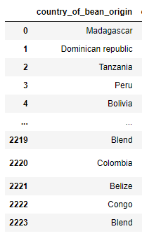
Machine Learning
Decision Tree
Used cross-validation with decision tree to evaluate model accuracy
Problem?
Our categorical predictor variables are not suitable to be used in model
Solution?
One-Hot Encoding→ convert our data to numeric form (disregard ordinality) to be used in model

Slide 18
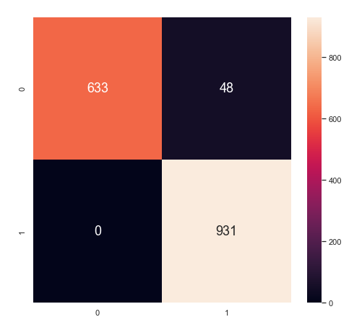
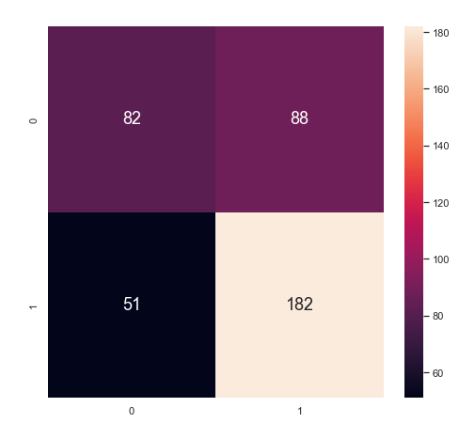
Decision Tree
Train Data
Classification Accuracy: 0.970
True Positive Rate: 1.0
True Negative Rate: 0.929
False Positive Rate: 0.07
False Negative Rate: 0.0
Test Data
Classification Accuracy: 0.655
True Positive Rate: 0.78
True Negative Rate: 0.48
False Positive Rate: 0.517
False Negative Rate: 0.218
Repeated Stratified K Fold:
Accuracy: 0.672
Precision: 0.699
Recall: 0.762
F1 score: 0.729

Slide 19
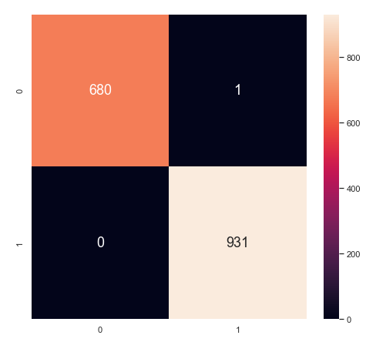
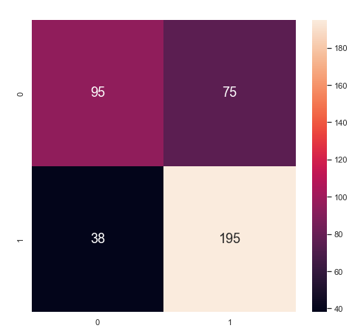
Random Forest
Train Data
Classification Accuracy: 0.99
True Positive rate: 1.0
True Negative rate: 0.998
False Positive rate: 0.001
False Negative rate: 0.0
Test Data
Classification Accuracy: 0.719
True Positive rate: 0.836
True Negative rate: 0.558
False Positive rate: 0.441
False Negative rate: 0.163
Repeated Stratified K Fold:
Accuracy: 0.723
Precision: 0.723
Recall: 0.846
F1 score: 0.779

Slide 20


Random Forest
ADASYN
Upsampling
Removing Minority Classes
Further improvements?

Slide 21


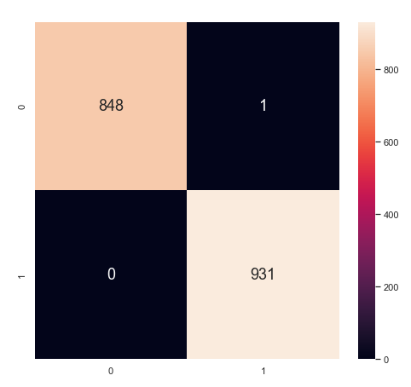
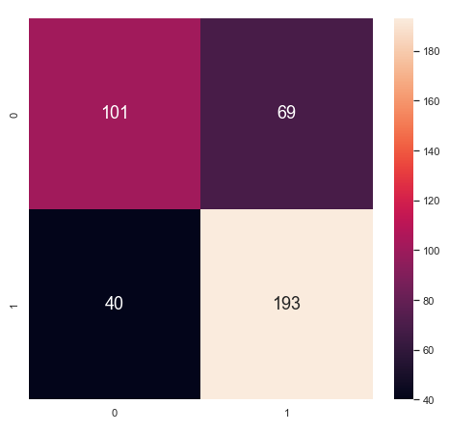
Random Forest
Upsampling (ADASYN)
Train Data
Classification Accuracy: 0.994
True Positive rate: 1.0
True Negative rate: 0.998
False Positive rate: 0.0011
False Negative rate: 0.0
Test Data
Classification Accuracy: 0.729
True Positive rate: 0.828
True Negative rate: 0.594
False Positive rate: 0.405
False Negative rate: 0.171
Repeated Stratified K Fold:
Accuracy: 0.720
Precision: 0.725
Recall: 0.830
F1 score: 0.774
Notes:
Better ability of predicting positive response variable

Slide 22

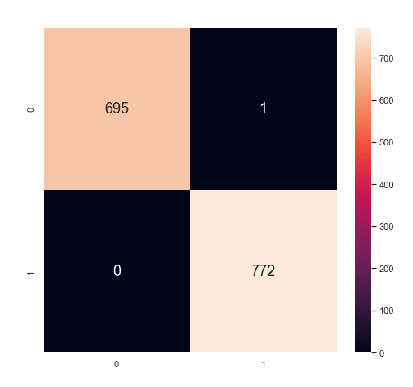
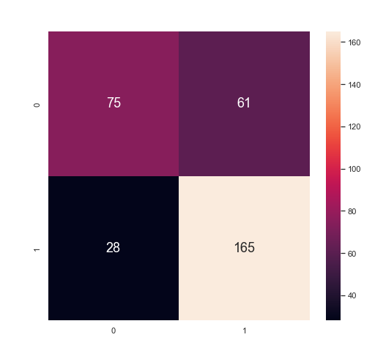
Random Forest
Minority Classes Removed
Train Data
Classification Accuracy: 0.999
True Positive rate: 1.0
True Negative rate: 0.998
False Positive rate: 0.001
False Negative rate: 0.0
Test Data
Classification Accuracy: 0.729
True Positive rate: 0.854
True Negative rate: 0.55
False Positive rate: 0.448
False Negative rate: 0.145
Skew: 2.22 0.98
Kurtosis: 4.53 -0.52
Repeated Stratified K Fold:
Accuracy: 0.719
Precision: 0.718
Recall: 0.860
F1 score: 0.783
Notes:
Actually resulted in worse accuracy

Slide 23
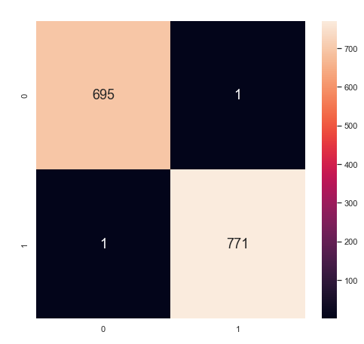
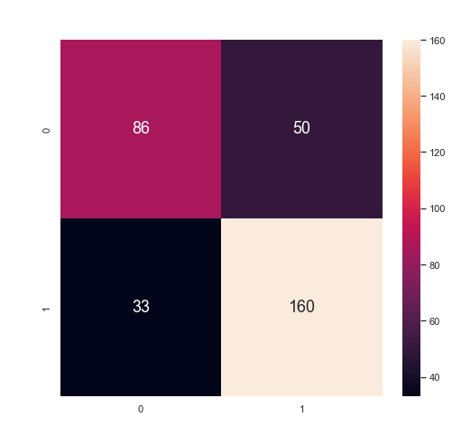
Gradient Boosting
Train Data
Classification Accuracy: 0.998
True Positive rate: 0.998
True Negative rate: 0.998
False Positive rate: 0.0014
False Negative rate: 0.0012
Test Data
Classification Accuracy: 0.748
True Positive rate: 0.829
True Negative rate: 0.632
False Positive rate: 0.367
False Negative rate: 0.170
Repeated Stratified K Fold:
Accuracy: 0.725
Precision: 0.743
Recall: 0.812
F1 score: 0.776

Slide 24

Analysis
Why did it not perform as well as expected?
Only 2 or 3 columns out of over 20 showed significant correlation
The ingredient columns showed very little correlation
A better way to deal with the “taste” category
Notes:
Why did the models not perform as well as expected? We suspect firstly, there were not enough variables. The ingredient variables had suprisingly low correlation with the rating category, and

Slide 25
Outcome & Conclusion
04

Slide 26
Conclusion
New Techniques:
Chi-squared Test
One-Hot Encoding
Random Forest
Gradient Boosting
Cross validation and SMOTE
Outcome:
We found some variables that have a discernible impact on chocolate bar ratings.
The variables while could not predict a high chocolate bar rating perfectly, but was able to point out a large number of high rated ones.

Slide 27
Conclusion
Data-Driven Insights:
Number and types of taste has more impact compared to ingredients of chocolate
Rich and creamy are some of the more prevalent tastes in chocolates with high rating
Countries like Ecuador and Guatemala tend to produce cocoa beans that are used in more high rating chocolates
Most high-rating chocolates are made up of 70-73% cocoa

Slide 28
Recommendations
More detailed info about the ingredients:
The specific amounts of each ingredients
“Have” and “not have” values
Similar tastes described in different ways:
“cocoa”, “rich cocoa”, “mild cocoa”, “
“off”, ”off note”, “off notes”, “off aroma”
“mild cacao and fruit notes”
Sentiment analysis: “why bother”, “wtf”

Slide 29
THANK YOU

Slide 30
References
Dark chocolate market size, share, scope, Opportunities & Forecast. Verified Market Research. (2021, November 24). Retrieved from https://www.verifiedmarketresearch.com/product/global-dark-chocolate-market/
Alakh Sethi. (2020, June 25). Categorical encoding: One hot encoding vs label encoding. Analytics Vidhya. Retrieved from https://www.analyticsvidhya.com/blog/2020/03/one-hot-encoding-vs-label-encoding-using-scikit-learn/
MediLexicon International. (n.d.). Chocolate: Health benefits, facts, and research. Medical News Today. Retrieved from https://www.medicalnewstoday.com/articles/270272#benefits
Gupta, (2022). Module 4 Topic 1: Binary Classification [PowerPoint Slides]. Retrieved from NTULearn course site.
RandomForestClassifier (2022). scikit-learn. Retrieved from https://scikit-learn.org/stable/modules/generated/sklearn.ensemble.RandomForestClassifier.html
Brownlee, J. (2019, October 21). A Gentle Introduction to the Chi-Squared Test for Machine Learning. Machine Learning Mastery. Retrieved from https://machinelearningmastery.com/chi-squared-test-for-machine-learning/
Brownlee, J. (2021, April 26). Gradient boosting with Scikit-learn, XGBoost, LIGHTGBM, and CatBoost. Machine Learning Mastery. Retrieved from https://machinelearningmastery.com/gradient-boosting-with-scikit-learn-xgboost-lightgbm-and-catboost/

